Slide 1




Facticity, Complexity and Big Data
Pieter Adriaans
IvI, SNE group Universiteit van Amsterdam

Slide 2
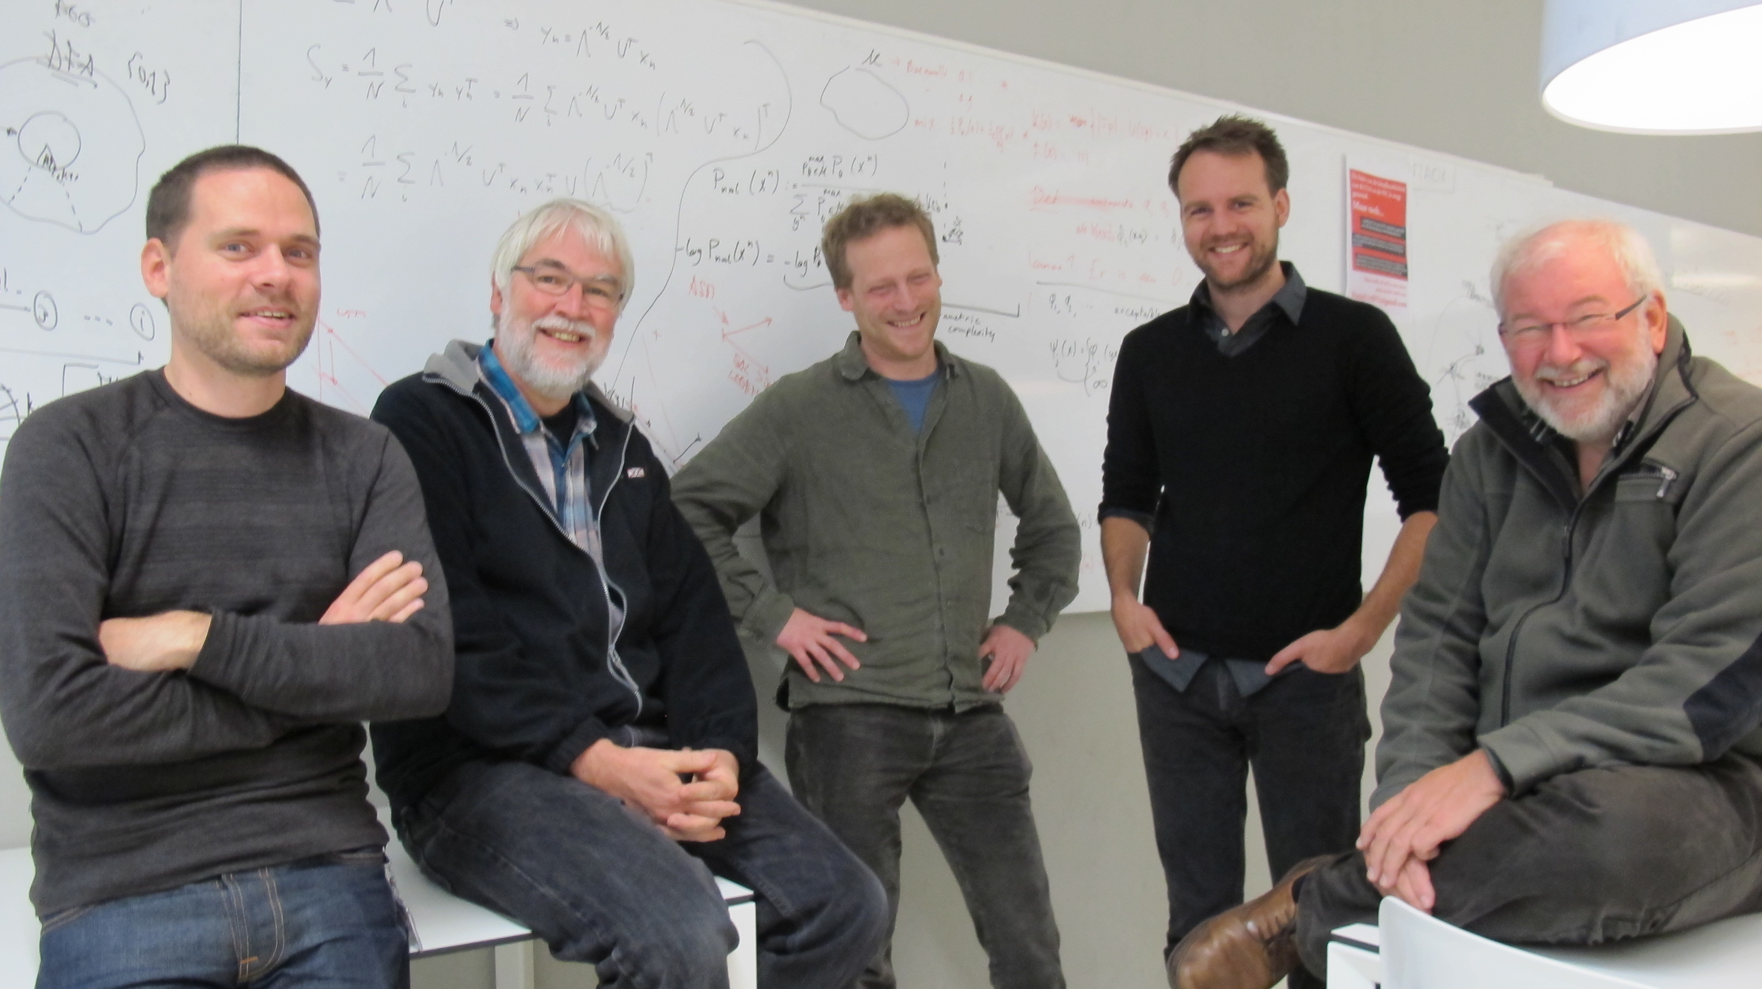

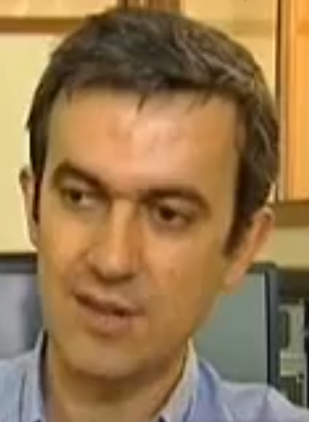
Gerben de Vries, Cees de Laat, Steven de Rooij, Peter Bloem, Pieter Adriaans
Group of
Frank van Harmelen
Vrije Universiteit
Group of
Luis Antunes
Universidade do Porto

Slide 3






Slide 4






1
2
3
4
5
6

Slide 5
Need for new measure(s) of information
Esthetic Measure (Birkhoff, Bense)
Sophistication (Koppel)
Logical Depth (Bennet)
Statistical complexity (Crutchfield, Young)
Effective complexity (Gell-Mann and Lloyd)
Meaningful Information (Vitanyi)
Self-dissimilarity (Wolpert and McReady)
Computational Depth (Antunes et al.)

Slide 6
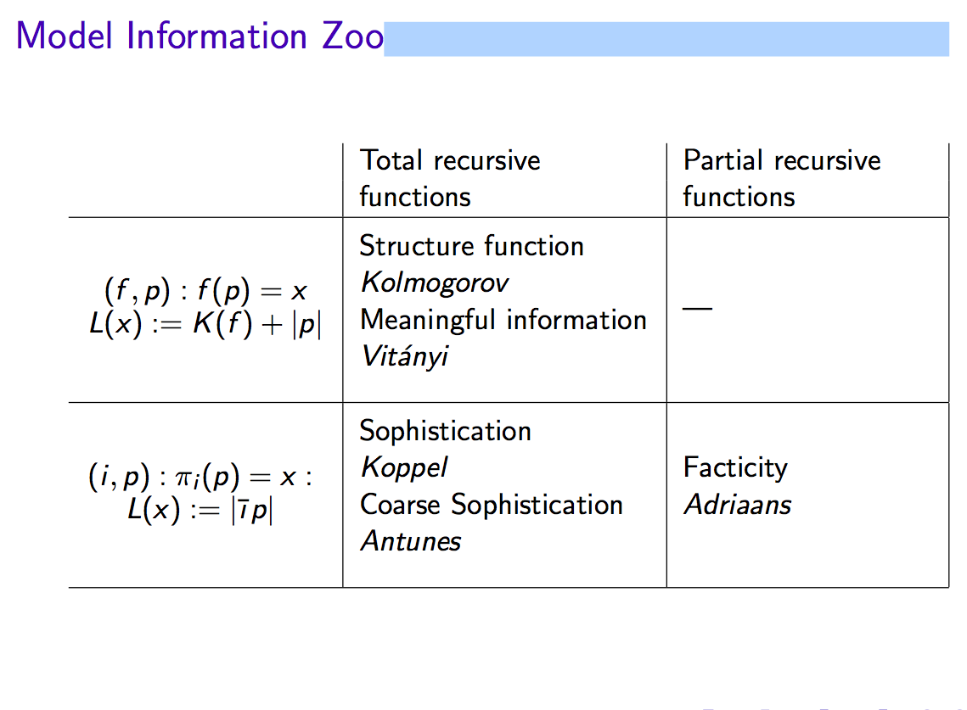

Slide 7
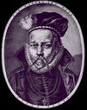
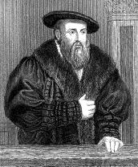
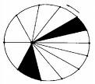

Research cycle
System
Observations
Processing
model

Slide 8
Some examples
Data: D | Structural Theory: T | Ad Hoc Part: T(D)
Description of our solar system | Keppler’s laws | Trajectories and mass of the planets
Reuters data base | English grammar | The order of the individual sentences
A composition by Bach | Bach’s style | Themes, repetition etc.

Slide 9
Basic Intuition: learning is data compression
regularities in the data set allow us to compress the data set.
If the data set is ‘representative’ then regularities in the training set will be representative for regularities in an unseen test set.

Slide 10
Some conventions
Universe
U = Universe
M = Model
D = Data Set
For the moment M and D are finite
|M| = m
|D| = d
Model
Data

Slide 11
Selecting the best model according to Bayes
Universe
Model
Data
Model Code
Data to Model Code
Optimal Shannon Code

Slide 12
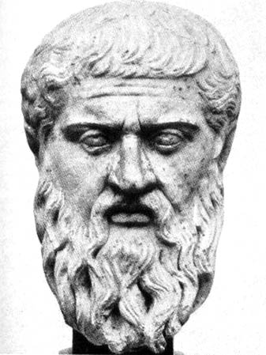
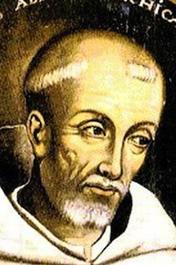

The minimum description length (MDL) principle: J.Rissanen
The best theory to explain a set of data is the one which minimizes the sum of: - the length, in bits, of the description of the theory and - the length, in bits, of the data when encoded with the help of the theory

Slide 13
Two-part code optimal compression given a model class C
Data D
Model Code
11
0
n
Data to Model Code
Facticity
Residual Entropy

Slide 14
Facticity
Objective: Studies the balance between structural and ad hoc data in (large) data sets.
Methodology: Kolmogorov complexity.
Model class: partial recursive functions (all possible computer programs).
Most general theory of model induction we currently have.

Slide 15
Turing two-part code optimal compression
Data x
Index
Program
11
0
n
i
p
Facticity
Residual Entropy
Kolmogorov complexity
Randomness Deficiency

Slide 16
Turing two-part code optimal compression
Program
Index

Slide 17
Two problems (and their solutions)
Kolmogorov complexity is not computable?
A Safe Approximation for Kolmogorov Complexity, P Bloem, F Mota, S de Rooij, L Antunes, P Adriaans - Algorithmic Learning Theory, 2014
Are indexes of TM’s indexes a reliable measure for model complexity (Nickname Problem)?
Invariance theorem for indexes (Bloem, de Rooij 2014): there is a compact acceptable enumeration of the partial recursive functions

Slide 18
Facticity of random strings
Program

Slide 19

Facticity for compressible datasets with small K(x)
Program
Index

Slide 20
Facticity for large compressible sets:
Collapse onto smallest Universal Machine
Program
Index

Slide 21
Collapse point Conjecture
If we have a data set D and a Universal Turing machine U_{u} such that:
then U_{u} will be the preferred model under facticity.
Realistic example: If |u|= 20 then all models above 10⁶ bits will collapse

Slide 22
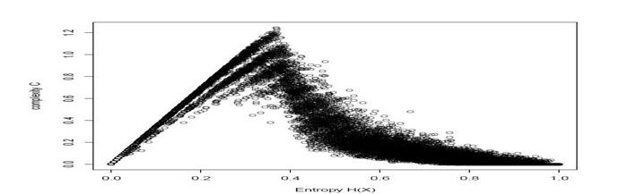
Zero probability
Optimal Facticity
=
Edge of Chaos
=
Maximal instability
Max φ(x) = δ(x)
Max K₂ (x) = φ(x)
Zero probability
φ(x)
Zero probability
Absolutely non-stochastic strings
Low density
Low probability
Non-stochastic models
mixed
Low density
High probability
stochastic models
High density
Low probability
K(x)=0
K(x)=|x|

Slide 23
Some applications
The notion of an ideal teacher
Modeling non max entropy systems in physics
game playing (digital bluff poker)
Honing’s problem of the ‘surprise’ value of musical information
dialectic evolution of art
the problem of interesting balanced esthetic composition
optimal product mix selection
Schmidhuber’s notion of low complexity art
and Ramachandran’s neuro esthetics

Slide 24
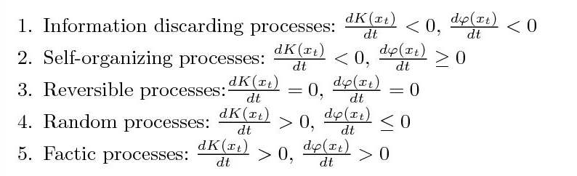
Classification of processes
Random process
Recursive process
Factic Process

Slide 25
Factic processes
Are the only processes that create meaningful information (random processes and deterministic processes do not create meaningful information)
Have no sufficient statistic
Are characterized by:
Randomness aversion: A factic process that appears to be random will structure itself.
Model aversion: A factic process is maximally unstable when it appears to have a regular model.
Are abundant in nature: game playing, learning, genetic algorithms, stock exchange, evolution,etc.

Slide 26
Regular Languages: Deterministic Finite Automata (DFA)
a
aa
abab
abaaaabbb
0
1
a
b
b
b
b
a
2
3
a
{w ∈{a,b}* | # a^{W} and # a^{W} both even}
DFA = NFA (Non-deterministic) = REG

Slide 27
An example state (read 0) (read 1) (read b)
of a simple
DTM program q₀ q₀,0,+1 q₀,1,+1 q₁,b,-1
Is in the matrix
q₁ q₂,b,-1 q₃,b,-1 q_{N},b,-1
q₂ q_{y},b,-1 q_{N},b,-1 q_{N},b,-1
q₃ q_{N},b,-1 q_{N},b,-1 q_{N},b,-1
The
machine is
In state q₀
The read/
write head
reads 0
Writes a
0
moves (+1)
one place
to the right
State
changes
To q₀
+1
(state q₀)
b b 1 0 1 0 0 b b b
q₀
program
This program accepts string that end with ’00’

Slide 28
Graph of Delta function of TM
0
q2
qN
0
0
q0
q1
b
qN
1
q3

Slide 29
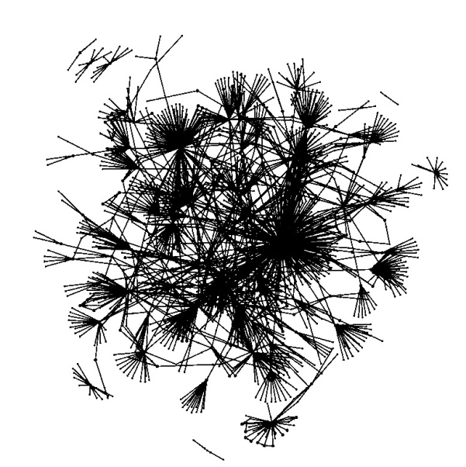
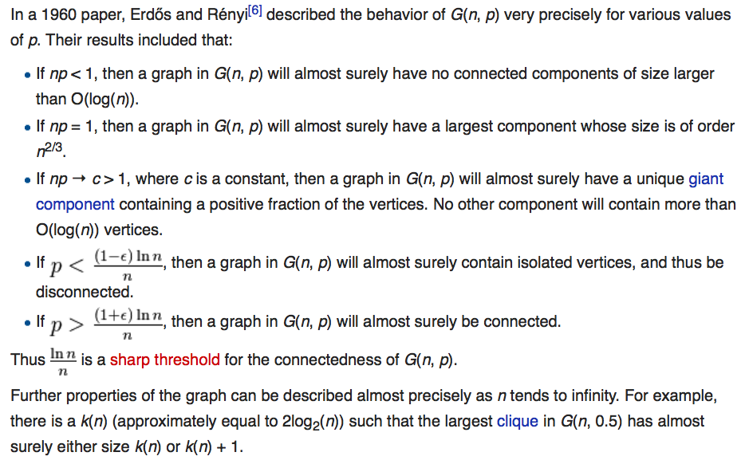
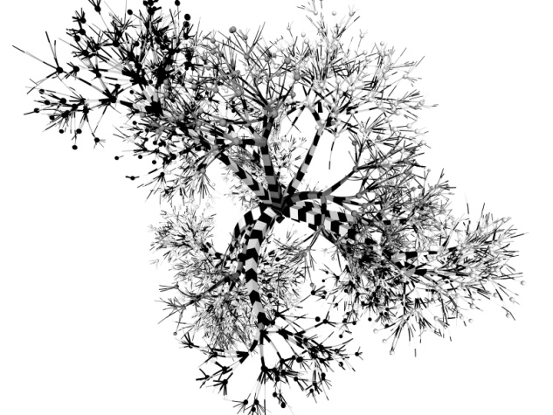
Erdős–Rényi models Percolation models
a
0
1
a
b
b
b
b
a
2
3
a
0
q2
qN
0
0
q0
b
q1
qN
1
q3

Slide 30
Conclusions Further research
Compression based automated model selection for unique strings? No!
Is Big Data just more Simple data? No!
What is a really complex system? Collapse Conjecture: model collapse phenomena are relevant for the study of complex systems in the real world. (Brain, Cell, Stock Exchange etc.)
Wat are viable restrictions on model classes?

Slide 31
Additional material

Slide 32
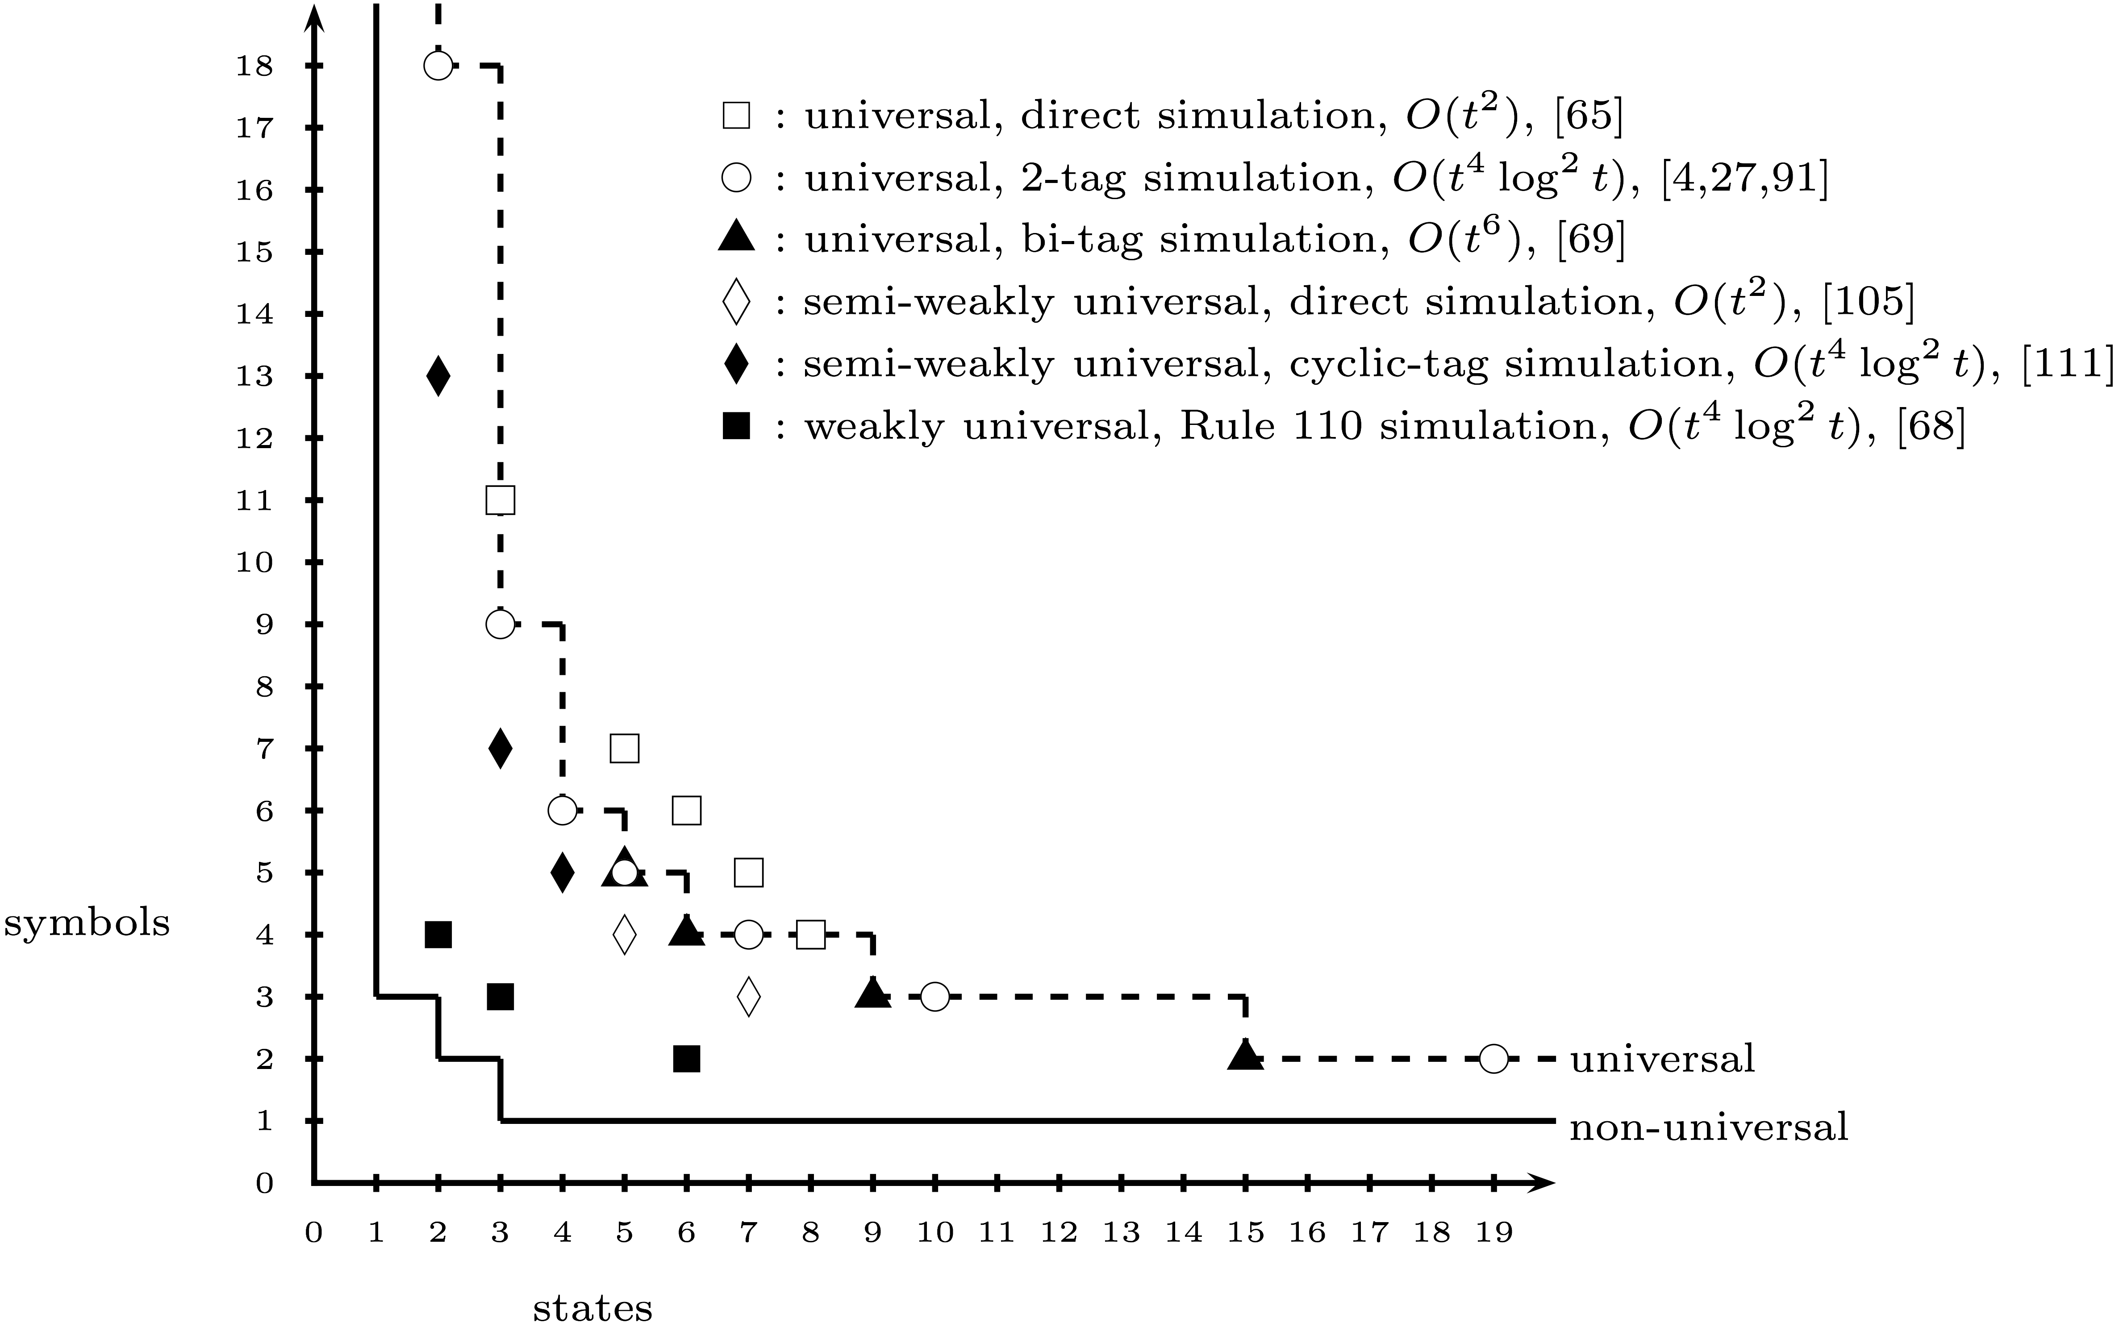
There are very small universal machines
Neary, Woods SOFSEM 2012

Slide 33
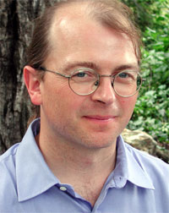
And very large data sets
10^10 bits Human genetic code
10^14 bits Human brain
10^17 bits Salt cristal at quantum level
10^30 bits Ultimate laptop (1 kg plasma)
10^92 bits Total Universe
10^123 Total number of computational steps since Big Bang (Seth Lloyd)

Slide 34
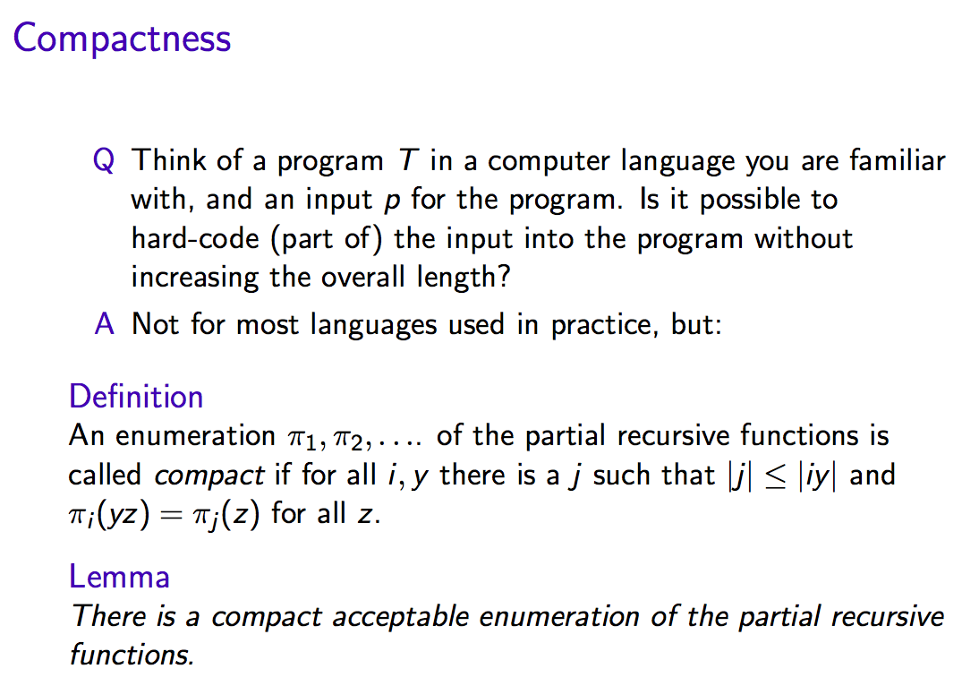

Slide 35
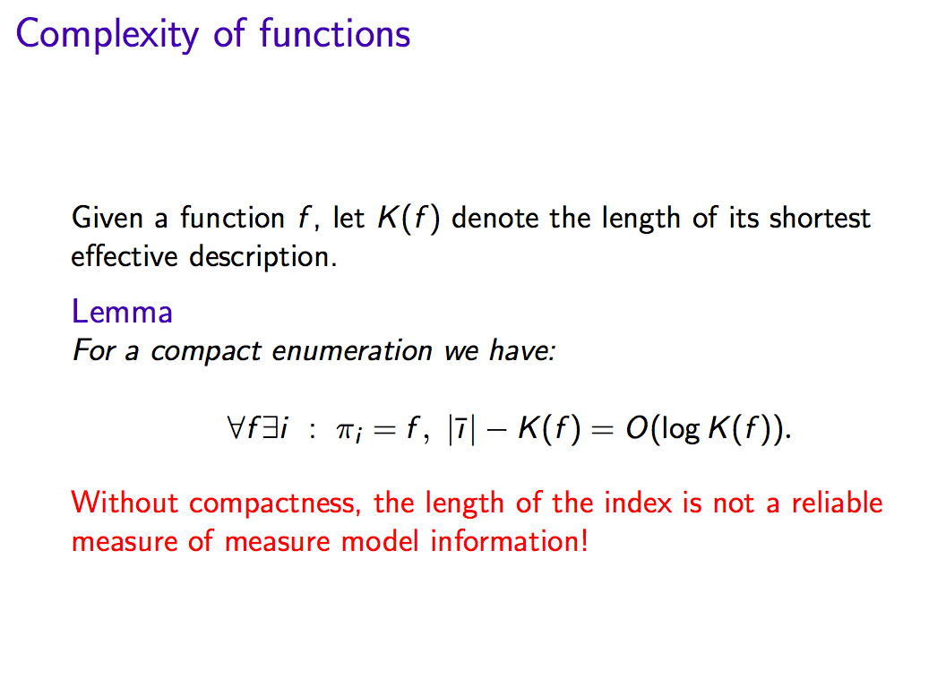

Slide 36
